Slide 1
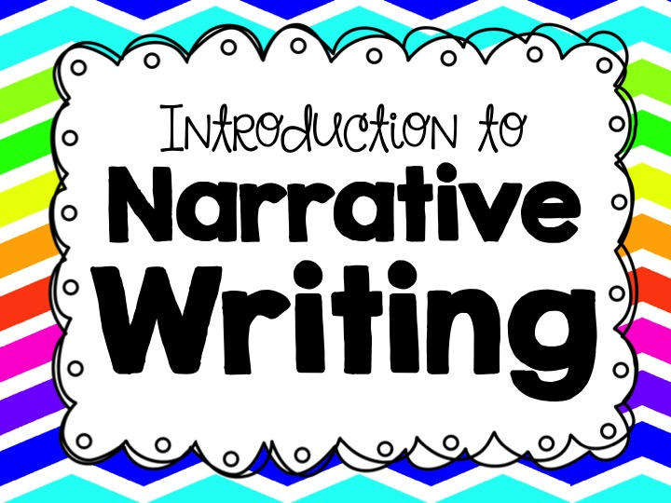

Slide 2
What is a narrative?
A narrative is a story made up of real or imagined experiences.
A personal narrative is an account of events from your life.
A fictional narrative is a made up story.

Slide 3
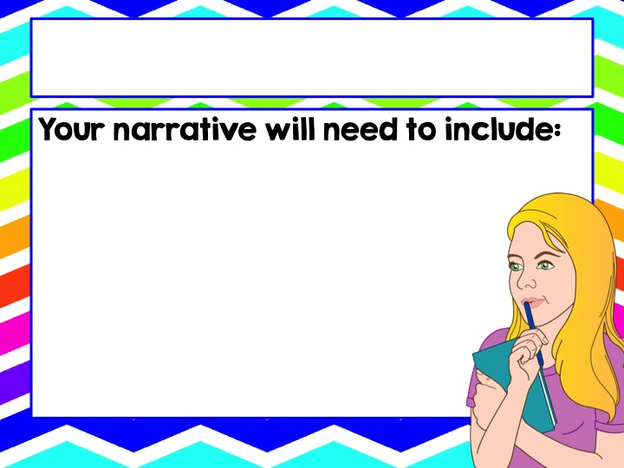
Writing a Narrative
characters (a protagonist and antagonist)
a setting
a plot
a conflict (external or internal)
a point of view
a climax
a conclusion

Slide 4
The Narrative Elements
Character – a person depicted in a work of fiction.
Protagonist - the leading character or one of the major characters in a drama, movie, novel, or other fictional text
Antagonist - a person who actively opposes or is hostile to someone or something; an adversary

Slide 5
The Narrative Elements
Setting –the time and place a story is set.
When: What time does the story take place (hour of the day, day of the week, year, time period, season, etc.)?
Where: At what location does the story take place?

Slide 6

The Narrative Elements
Plot - the events take make up a storyline
Exposition
Inciting Incident
Rising Action
Climax
Falling Action
Conclusion

Slide 7
The Narrative Elements
Plot - the events take make up a storyline
Exposition
Inciting Incident
Rising Action
Climax
Falling Action
Conclusion
Introduces background information about events, settings, characters etc. to the audience or readers.

Slide 8
The Narrative Elements
Plot - the events take make up a storyline
Exposition
Inciting Incident
Rising Action
Climax
Falling Action
Conclusion
The event that sets the central conflict in motion.

Slide 9
The Narrative Elements
Plot - the events take make up a storyline
Exposition
Inciting Incident
Rising Action
Climax
Falling Action
Conclusion
A related series of incidents in a literary plot that build toward the point of greatest interest.

Slide 10
The Narrative Elements
Plot - the events take make up a storyline
Exposition
Inciting Incident
Rising Action
Climax
Falling Action
Conclusion
The point in a narrative at which the conflict or tension hits the highest point.

Slide 11
The Narrative Elements
Plot - the events take make up a storyline
Exposition
Inciting Incident
Rising Action
Climax
Falling Action
Conclusion
The part of a literary plot that occurs after the climax has been reached and the conflict has been resolved.

Slide 12
The Narrative Elements
Plot - the events take make up a storyline
Exposition
Inciting Incident
Rising Action
Climax
Falling Action
Conclusion
Concludes the entire story. Wraps up any loose ends and settles the story’s conflicts.

Slide 13
The Narrative Elements
Conflict - a literary element that involves a struggle between two opposing forces usually a protagonist and an antagonist.
External: a struggle between a character and an outside force (another character or nature).
Internal: a struggle happening within a character’s mind.

Slide 14
The Narrative Elements
Point of View - the narrator's position in relation to the story being told.
1st person: The narrator is in the story
EX: I woke up that morning and wanted to buy some ice cream.
3rd person: The narrator is an outsider telling the story
EX: He woke up that morning and wanted to buy some ice cream.

Slide 15
Dialogue
You will want your narrative to include dialogue.
Dialogue is when the characters speak to each other.
Punctuate dialogue with “quotation marks.”
Create a new paragraph each time a new character speaks.

Slide 16
Dialogue - Example
“Hello,” said Suzie. “How are you today?”
“I am doing well,” replied Javier. “Are you going to study for the math test tomorrow?”
“Yes. I really need to do well on it,” Suzie replied.

Slide 17
The Writing Process
Follow these steps to write a narrative
Prewriting
Drafting
Revising
Editing
Publishing

Slide 18
The Writing Process
Follow these steps to write a narrative
Prewriting
Drafting
Revising
Editing
Publishing
Brainstorm!
Think about what you want to write about.
Develop your characters, plot, setting, and conflict.
Complete an outline or storyboard for your narrative.

Slide 19
The Writing Process
Follow these steps to write a narrative
Prewriting
Drafting
Revising
Editing
Publishing
Write down your ideas
Create a working draft (a working draft is a draft that is in progress)

Slide 20
The Writing Process
Follow these steps to write a narrative
Prewriting
Drafting
Revising
Editing
Publishing
Read your working draft aloud.
Type your working draft into a translate program and have it read back to you.
Participate in peer editing.
Have as many people read your draft as possible.

Slide 21
The Writing Process
Follow these steps to write a narrative
Prewriting
Drafting
Revising
Editing
Publishing
Review all of your draft’s feedback.
Revise and change your paper as you see fit.
Read your revised draft aloud.

Slide 22
The Writing Process
Follow these steps to write a narrative
Prewriting
Drafting
Revising
Editing
Publishing
Type your final draft

Slide 23
Brainstorming
Let’s get started!
Think about the characters for your narrative.
Will the characters be you, a version of you, or completely made up?
How old will the characters be?
What will the characters look like?
How will the characters act?

Slide 24
Brainstorming
Let’s get started!
Think about the setting of your narrative.
Where will your narrative take place?
When will your narrative take place?
What is the weather like?
What are the surroundings like?

Slide 25
Brainstorming
Let’s get started!
Think about the conflict of your narrative.
What is the central conflict of your narrative?
Is it an external or an internal conflict?
Who are the opposing forces?
Why are these forces against each other?

Slide 26
Brainstorming
Let’s get started!
Think about the point of view for your narrative.
What point of view will you write your narrative in?
Will the narrator be a character in the story?
Will the narrator be a spectator?
Will the narrator have limited access to the characters and their thoughts?

Slide 27
Brainstorming
Let’s get started!
Think about the tone of your narrative.
What is the author’s attitude toward the characters?
What is the author’s attitude toward the setting?
What is the author’s attitude toward the conflict?

Slide 28
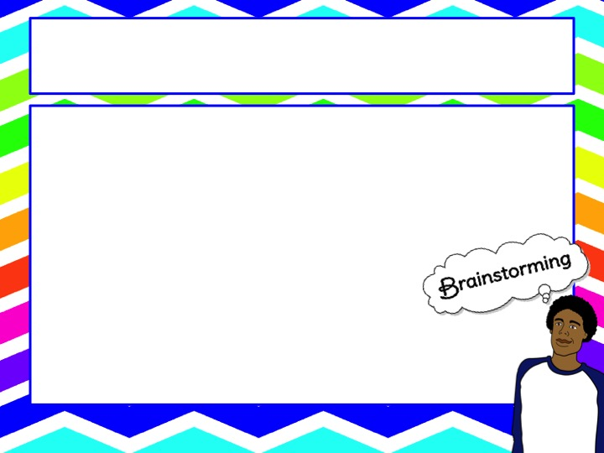
Brainstorming
Let’s get started!
Think about the plot of your narrative.
What is going to happen in your narrative?
What event will start
the central conflict?
How will the climax be resolved?

Slide 29
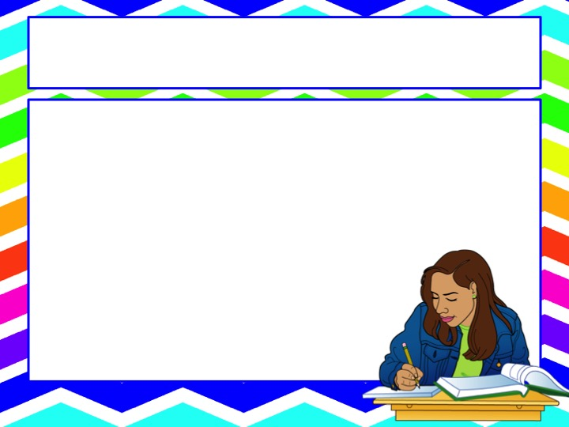
Drafting
Using all of the materials from the brainstorming process, get to work writing your first draft.
You can always go back and edit and revise your writing.
The key is to get your thoughts
onto the paper.

Slide 30
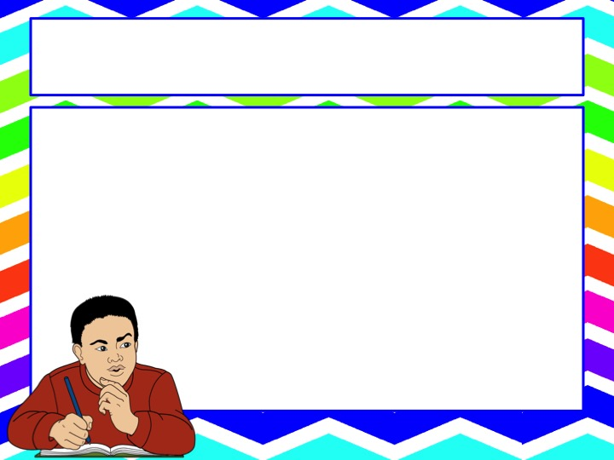
Revising
Once you complete your rough draft, read it aloud.
Type your rough draft into an Internet translator and have it read to you.
Participate in peer editing.

Slide 31
Editing
Review all of your notes and the peer review notes.
Revise your narrative to improve its quality and content.

Slide 32
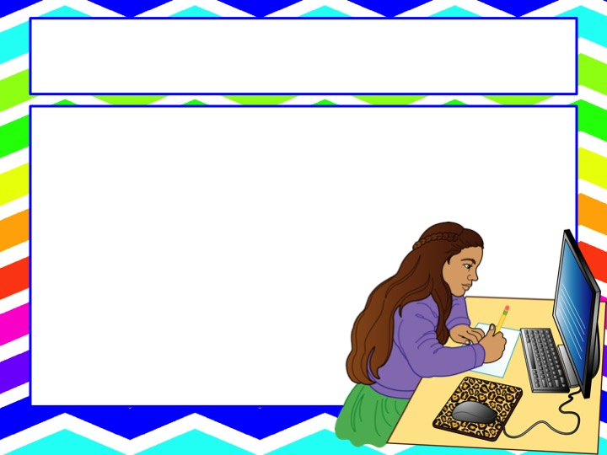
Publishing
Prepare the final draft of your narrative.
Type your narrative.

